Slide 1
TechStop
ESHA SHAH : C093
SACHI SHAH : C094
DEESHA SID : C097
Faculty Mentor: Prof. Krishna Samdani

Slide 2
Outline
Motivation
Introduction
Tools & Techniques
Simulation & Results
Conclusion
Future Work
Reference

Slide 3
Motivation
The age has advanced in the field of innovation thus has the utilization of innovations increased. There is a drastic change in the ages(generation). Because of this we have been dependant on the electronic gadgets. So we chose to have a program about the shopping and billing of the electronic devices.

Slide 4
Introduction
This Simple Electronic Store Management System known as TECH STOP is based on a concept of storing and selling electronic products. It is a concept to generate daily payment transactions bill.
A billing system is a complete solution that helps you in billing, build customer loyalty, manage customers, keep track of stock, payables and receivables, check reports and even more.
Electronic Store Management System is developed using C++ Programming .This mini project contains limited features, but the essential one.

Slide 5
Introduction
FEATURES:
USER : There is a login system for the user which accepts personal information like name ,email-id and phone number. Here, the user can view products and buy products of their own choice easily.
MANAGEMENT WITH FILES : Once the user selects a product , the information of the user and the product selected is simultaneously stored in a file for the future reference of the admin
ADMIN AND REPORTS :It also allows the admin to view reports like stock, sold and user once choices are made by the user.
GENERATION OF BILL:The total amount is calculated on the basis of item selected and amount of quantity entered by the user. And finally displayed in a bill.

Slide 6
FLOW OF THE PROGRAM

Slide 7
Tools & Techniques
TOOLS:
IDE: An integrated development environment (IDE) is a software application that provides comprehensive facilities to computer programmers for software development. An IDE normally consists of at least a source code editor, build automation tools, and a debugger. The IDE used in this project was Code Blocks.
COMPILER: A compiler is a software program that transforms high-level source code that is written by a developer in a high-level programming language into a low level object code (binary code) in machine language, which can be understood by the processor .

Slide 8
Tools & Techniques
HEADER FILES:
iostream – allows the programmer to take input and output from the console
fstream – allows the program to establish streams and communicate with text files
string – allows programmer to use string variables and functions
Iomanip – allows the programmer to use manipulators life setw, setfill etc.

Slide 9
Tools & Techniques
TECHNIQUES:
CLASSES
OBJECTS
LOOPS
JUMP STATEMENTS
FUNCTIONS
MANIPULATORS
FILE HANDLING
STATIC DATA MEMBERS

Slide 10
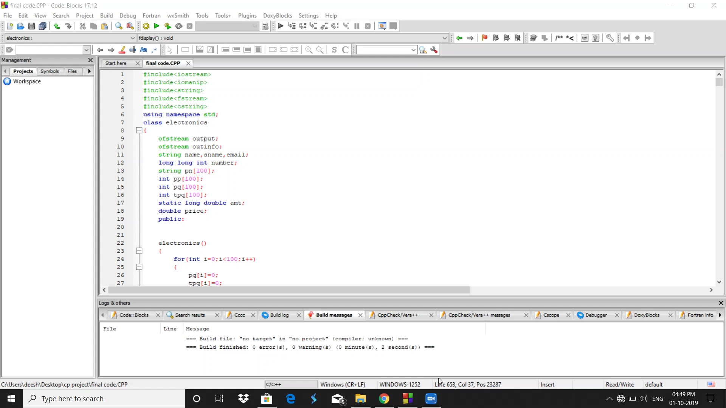
Simulation & Results USER

Slide 11

Simulation & Results ADMIN

Slide 12
Conclusion
Our billing system TECHSTOP is a system that receives personal information of the user ,groups this information for specific accounts or customer and stores it in a file to maintain records, provides various electronic option for the customer ,creates report for management and records payments made to the customer.
Some advantages of our system is that it makes billing fast and simple, reduces errors and disputes , reduces manual work, ,improves management and records, enhances transparency ,invoicing calculations are automated and standardized .this makes our system look more professional and well organized to the customers.

Slide 13
Future Work
TechStop is the system that focuses on mainly billing, generating reports
And essential features to carry out these functions.
But it may lack some features that are required for becoming an ideal billing and invoicing system. We would like to develop this system into an app/website by implementing these features.
These features include adding more products to provide a wide range of options, create an account for a user, provide with schemes beneficial for user.
Our future work also involves modification of the list of product selected by the customer, addition of new stock and products by the admin , include a wallet system for a existing user.
Also develop a functionality so as to enable the user to search a product based on criteria like most sold, a range of price etc.
In future we wish to work on this system and add more features and functionality thereby making it an efficient and a better system.

Slide 14


